Slide 1
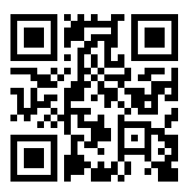
Climate in Mind
What could we do about the climate crisis?
How does it make you feel?
We seek participants for a study of people’s emotional responses to the climate crisis and related water issues and their decisions whether to participate in climate action.
Attend a free climate and water workshop with trained facilitators. Explore your feelings, participate in creative writing, and answer some short surveys.
Available dates: Fri 16th June 10:00-17:00: Online via MS Teams
Fri 23rd June 10:00-17:00: Online via MS Teams
Tues 11th July 10:00-17:00: University of Stirling Campus
Fri 18th Aug 10:00-17:00: University of Stirling Campus
Lunch and refreshments provided for in person workshops
For more information and to sign up: https://shorturl.at/pvDEJ
The study has received ethical approval from the University of Stirling.

