Slide 1
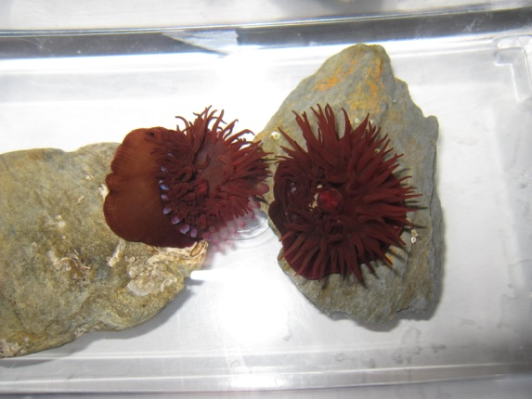
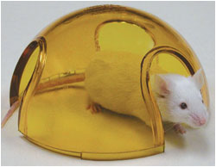
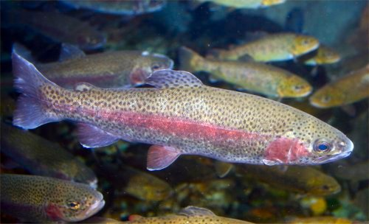
Joint meeting NC3Rs, ASAB and SEB
4-5th July 2012, London
No Registration Fees!
Poster Prize £1000
Implementing the 3Rs in behavioural and physiological research
Use of invertebrates
Behaviour and welfare
Toxicology
Neuroscience
Non-invasive sampling
Improved handing methods
Behavioural phenotyping
Development
WEB SITE: http://www.nc3rs.org.uk/event.asp?id=1673

