Slide 1
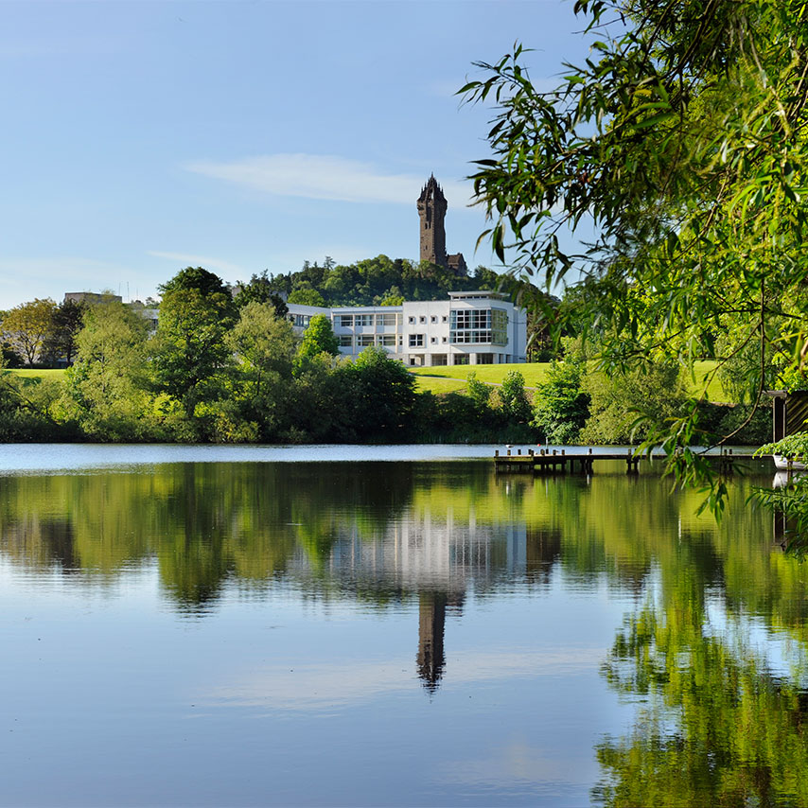
What next?

Slide 2
What support do you need and how can we help?
We really want to harness the excitement that came from the setting up of clusters and find opportunities to move those clusters forward. That will mean different things for different clusters.
Short term aim- make Festival of Research 22 May – 2nd June a focus for research and support you cluster to meet and take the next steps.
Use campus central as a focus for activity and networking.

Slide 3
What do you need (in the lead up to FoR)?
Book campus central rooms for focussed research times/meetings/ writing retreats
Involve more people in the cluster internal or external- networking or presentation activitiesy
Find out more about what other people/ clusters are doing?
Meetings with the funding team to explore funding opportunities
What grant size works for you? Do you need something small to lay the groundwork?
Use MSc projects to move work forward
Write the paper(s) that lays the groundwork for a grant
Talk to business engagement about how to work with them
Think about impact and make impact plans (tie into FOSS IAA?)
Design public engagement/ community engagement activities

Slide 4
Next steps
Pencilled in lunch time online sessions after school easter holidays, 12-1
Thursday 20th Friday 21st, (Monday 24th), Tuesday 26 April, 2 and 3 May
Possible planning meeting Tuesday 9th May 10-1130 in person
FoR rooms available morning and afternoon sessions 22nd May-2nd June
BUT what do you want/need? (that it is within our power to give)
Next year!?

